Slide 2
Architecture and zoning Parking space issues
Design of the parking spot
-> The current infrastructure needs to adapt (need of extra space on the front and the sides of a parking spot, electric infrastrucure on parking areas)
Possibility to have a parking spot at home (high density cities) or at work
20 million people cities ?

Slide 3
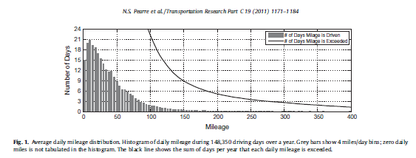
Architecture and zoning The range anxiety effect
95% of the days, mileage does not exceed 100 miles
-> enough for EV
But fear of being out of battery very strong in the minds

Slide 4
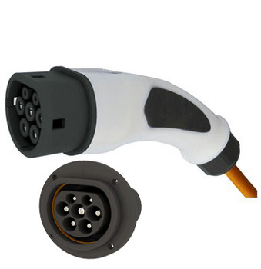
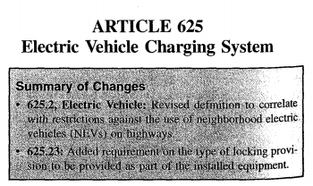
Regulations
Creation of new rules and standards:
→WHO? Companies (ChargePoint, CHAdeMO)
→WHAT? Plug in system, standardisation of the models to ONE model
Overview: Specific inlet/connector/plug/socket-outlet requirements, General system requirement and interface, Charging levels/Modes, Design standards …
Adaptations of existing rules and laws:
→WHO? Governments and organizations (International Electrotechnical
Commission, European Environment Grenelle …)
→WHAT? Creation of a section “EV charging stations” in the National
Electronic Code (NEC, US)
Overview: Rating of the supply voltage, Safety standards, Framework (Agents, Grids, metering, communication and control, …)

